Slide 1
Open-Coding Analysis
By Jun Linwu & Candice Liang

Slide 2
Initial Codebook
We start out with very specific categories
i.e. tutor, instructor, peer
Result in kappa < 0.8
Different standard on what consider as the “best” when the text mentions multiple(>3) strategies.

Slide 3
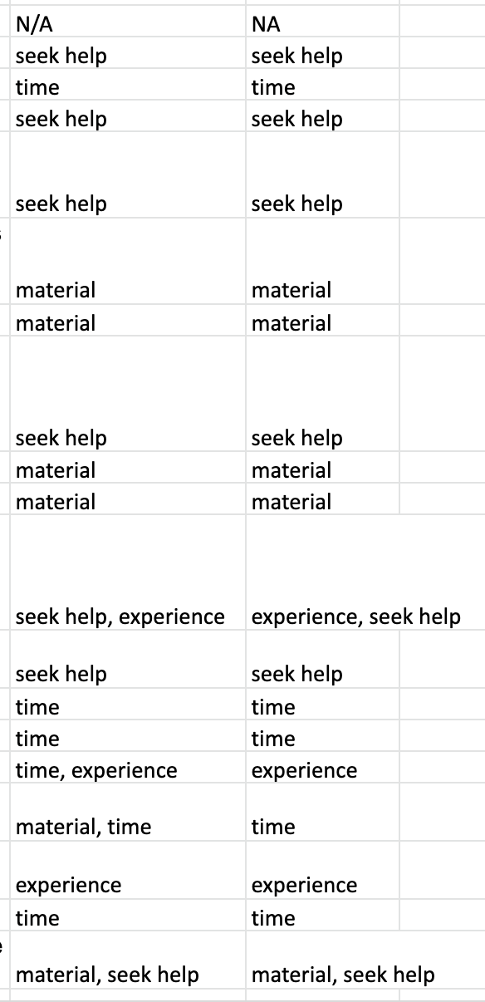
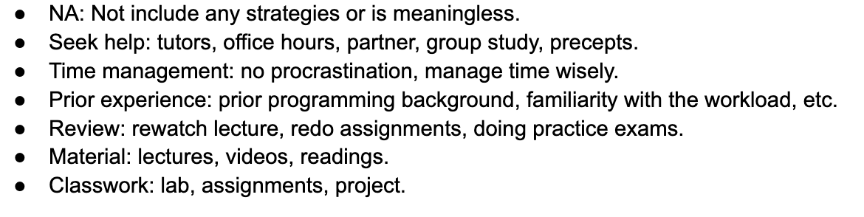
Revised Codebook
Decided to use more generalized categories
i.e. seek help
Final code list

Slide 4
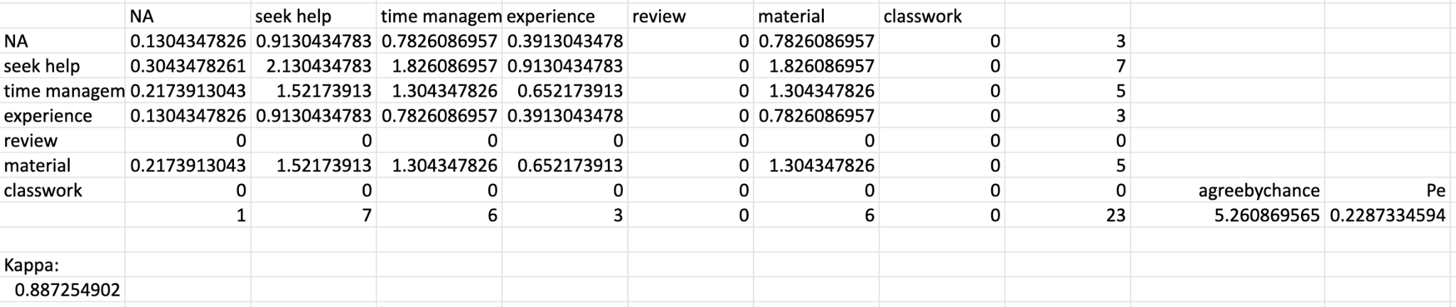
Final Codebook
Kappa = 0.89

Slide 5
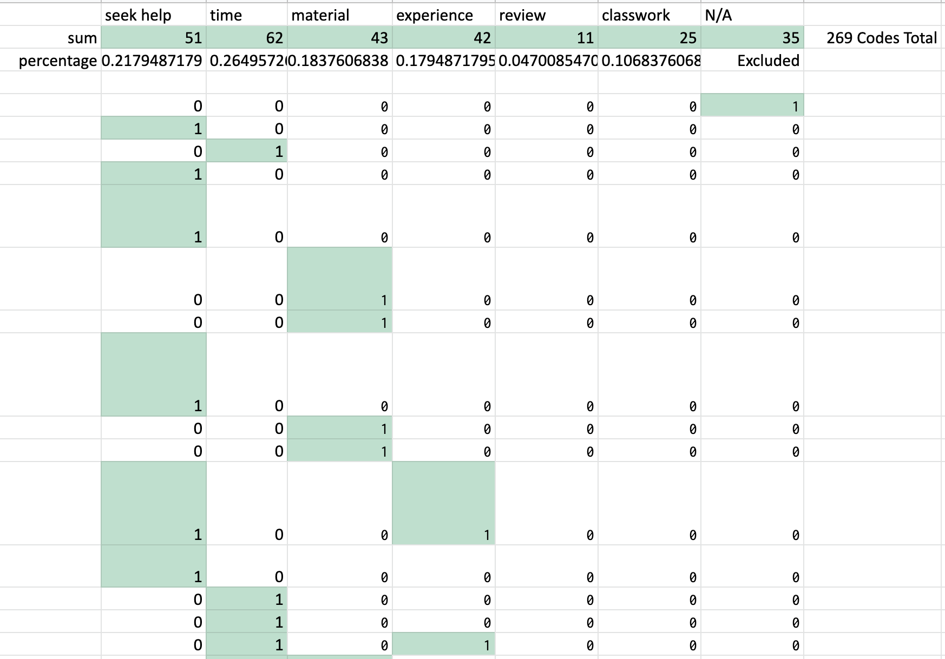
Observation
Notes:
Time management: 62 (26.5%) Seek help: 51 (21.8%) Material: 43 (18.4%) Prior experience: 42 (17.9%) Classwork: 25 (10.7%) Review: 11 (4.7%)

Slide 6
Time management
31
11
10
1
1
2
6
Seek help
21
19
Experience
3
4
12
18
Material

Slide 7
Observation cont.
6 people mention BOTH seek help & experience
15 people mention BOTH seek help & time management
15 people mention BOTH experience & material
18 people mention BOTH seek help & material
19 people mention BOTH time management & experience

Slide 8
Implication
INTRO class yet turn out to be beginner unfriendly?
To fully understand the material, student would either depends on their prior knowledge or extra help from others.
Students start the assignments early so they have enough time to ask questions.

Slide 9
Limitation
Our code did not reflect actual quote well.
Some information were hidden by our code.
i.e. Can’t tell whether the strategies were given to all students or to students without backgrounds only.
Generalized code leads to vague conclusion
Less helpful when comes to real-world application

Slide 10
Thank you for watching.

